Slide 1


Ministry Name: Ministry of Petroleum and Natural Gas Problem Statement: Technological advances for Retail Outlets Team Name: IoCrazoN Team Leader: Ms Pragati Chauhan College Code: 1-3512790486
Problem Category: Software
PS Number: AJ129
Problem Category: Hardware
PS Number: #AJ130

Slide 2
IDEA Details
Problem 1: Sensor to convey the customer about the actual quantity product delivered .
Solution devised: By using Flow rate sensor to measure the quantity of a flowing liquid which will provide the most accurate and repeatable flow measurements for our application.
Problem 2: Sensor to measure the fuel quality & display it along with some quality parameters too
Solution devised: Our proposed device which will be put on Dispenser nozzel with display various parameters of fuel quality to customers like. Fuel density.
Problem 3: Analysing & storing all datas.
Solution devised: Through NodeMCU ESP8266 module our device will send datas like. Total Fuel quantity received at one dispensing unit & total quantity given to customer periodically , the price at which fuel is given, the quality of fuel etc. to the server of the centralised authority.
Technology stack
Amazon Web Service (IOT) : This service allows us to connect our devices to the internet for processing, operating and exchanging data securely.
NodeMCU (Node MicroController Unit) is an open source software and hardware development environment that is built around a very inexpensive System-on-a-Chip (SoC) called the ESP8266.
Python , Java Script ,HTML,CSS and Arduino IDLE.

Slide 3

FEATURES
Fully Automated
Highly Durable and Efficient
Used to maintain the data on the server
Economically feasible

Slide 4
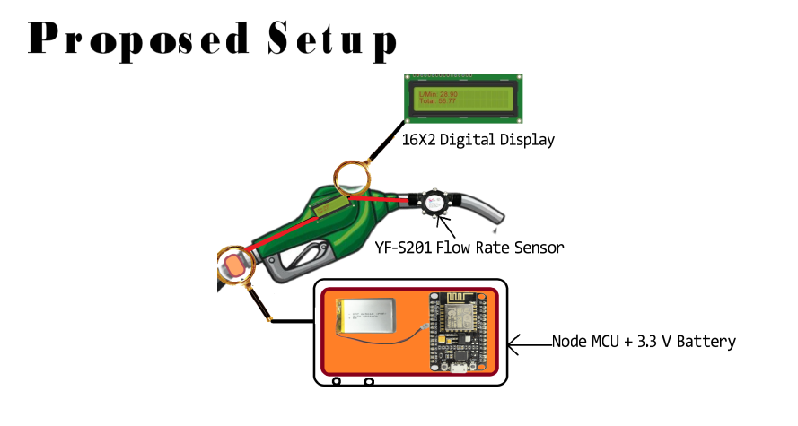

Slide 5
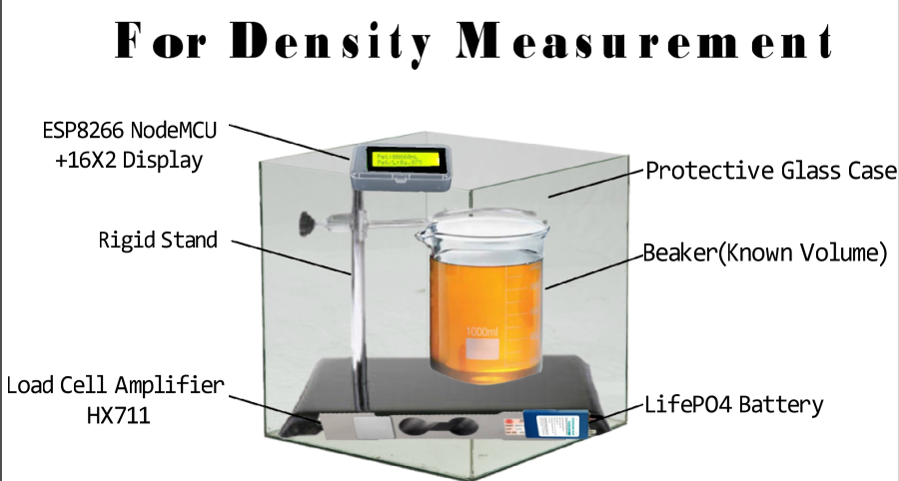

Slide 6
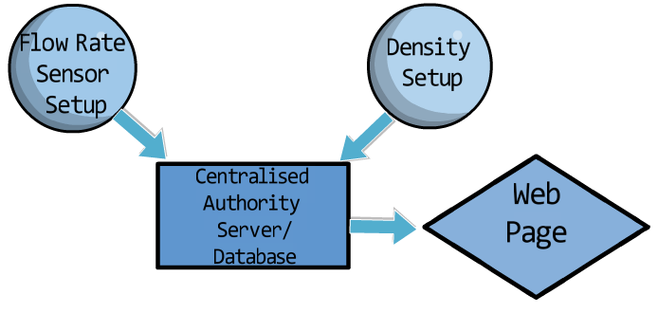

Slide 7
Novelty
Digital monitor for fuel dispenser unit to maintain logistics and demand estimation
Customer friendly as free from human interference
Our device will send datas like daily fuel consumption, Total Fuel quantity received at one dispensing unit & total quantity given to customer periodically , the price at which fuel is given, the density of fuel etc. to the server of the centralised authority.

Slide 8
Future Scope
We are planning to combine the two setup to make a single volume and make it detachable.
Planning to make it temper proof
A single neutral agency appointed to manufacture & distribute to avoid duplicacy.
Tie-up with the company to make our setup more optimised that can be fitted in the fuel tank of the customer.

